Slide 1
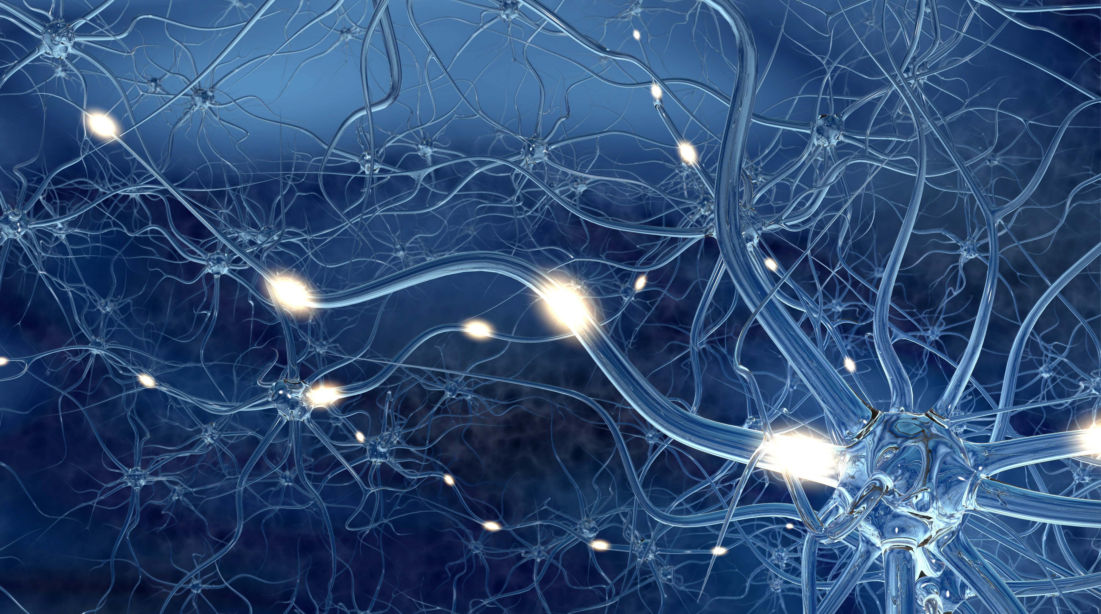
Neurodynamical computing at the information boundaries of intelligent systems
APS/DBIO Neurodynamical Models of Cognition // March 8, 2023
Joseph D. Monaco, SelfMotion Labs & National Institutes of Health
Grace M. Hwang, Johns Hopkins Applied Physics Lab & National Science Foundation

Slide 2
Outline
Toward a nonreductive dynamical neuroscience of intelligence
Briefly review disciplinary approaches to formalizing biological intelligence
  Highlight persistent gaps in concepts, theories, and hypotheses
Motivate a perceptual control framework for resolving external observer bias
  Informational implications for cognitive computing with neural dynamics
Synthesize structure and temporal properties of mammalian hippocampal-cortical networks
  Oscillations, dynamical articulation, and agency

Slide 3

Three paths…
Framing an integrative (computational) neuroscience of intelligence
Cybernetics→
Cognitive Science
GOFAI→
“Third Wave” AI learning and reasoning
Behaviorist Psychology→
Mainstream neuroscience
  Physics of neural systems→
  Computational neuroscience

Slide 4
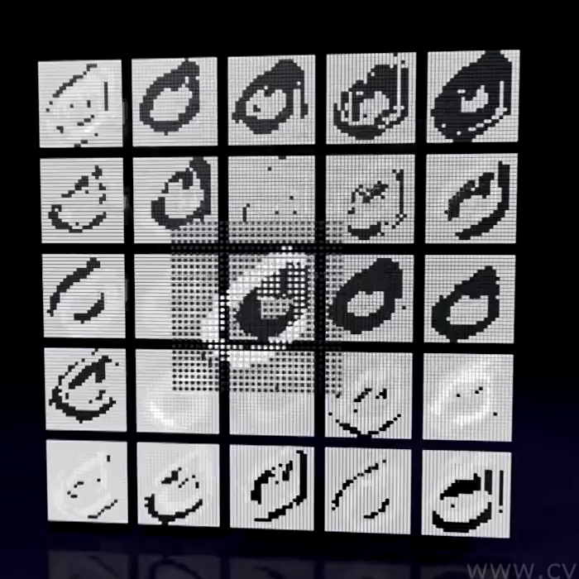
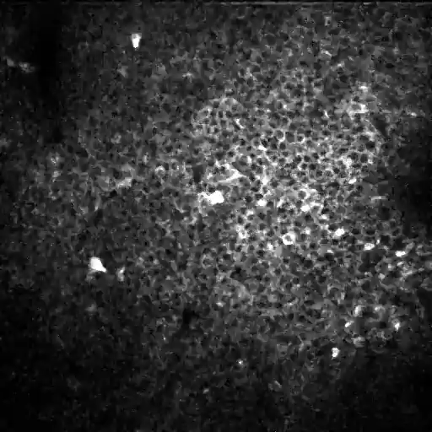
500x500 µm f.o.v. over mouse CA1 of synapsin-driven GCaMP6f during training in an olfactory working-memory task.
Video Credit: J. Taxidis

Slide 5
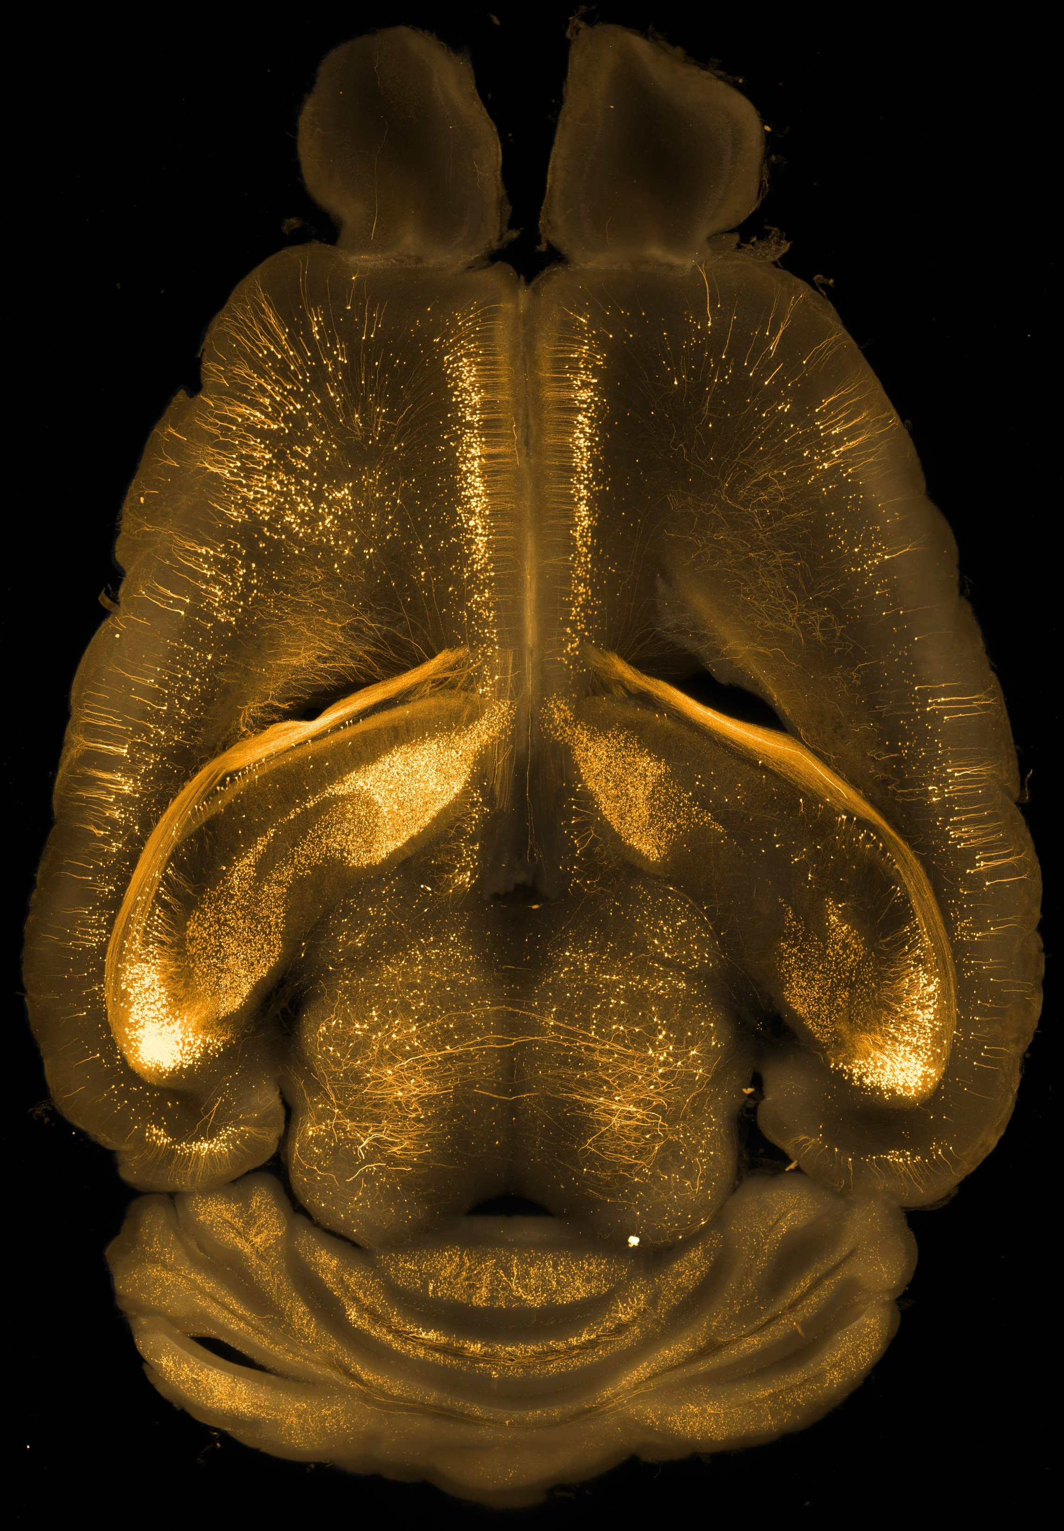
External observer bias
Inverting the input-output paradigm
Computational metaphors for the brain have entrenched the behaviorist bias that externally observable output is the endpoint of brain function
Neuroscience and AI have both embraced this bias, with either explicit or implicit input and output layers for computations
Implied control paradigm is one of building forward (predictive) models
Image Credit: Glazer et al. (PEGASOS)

Slide 6
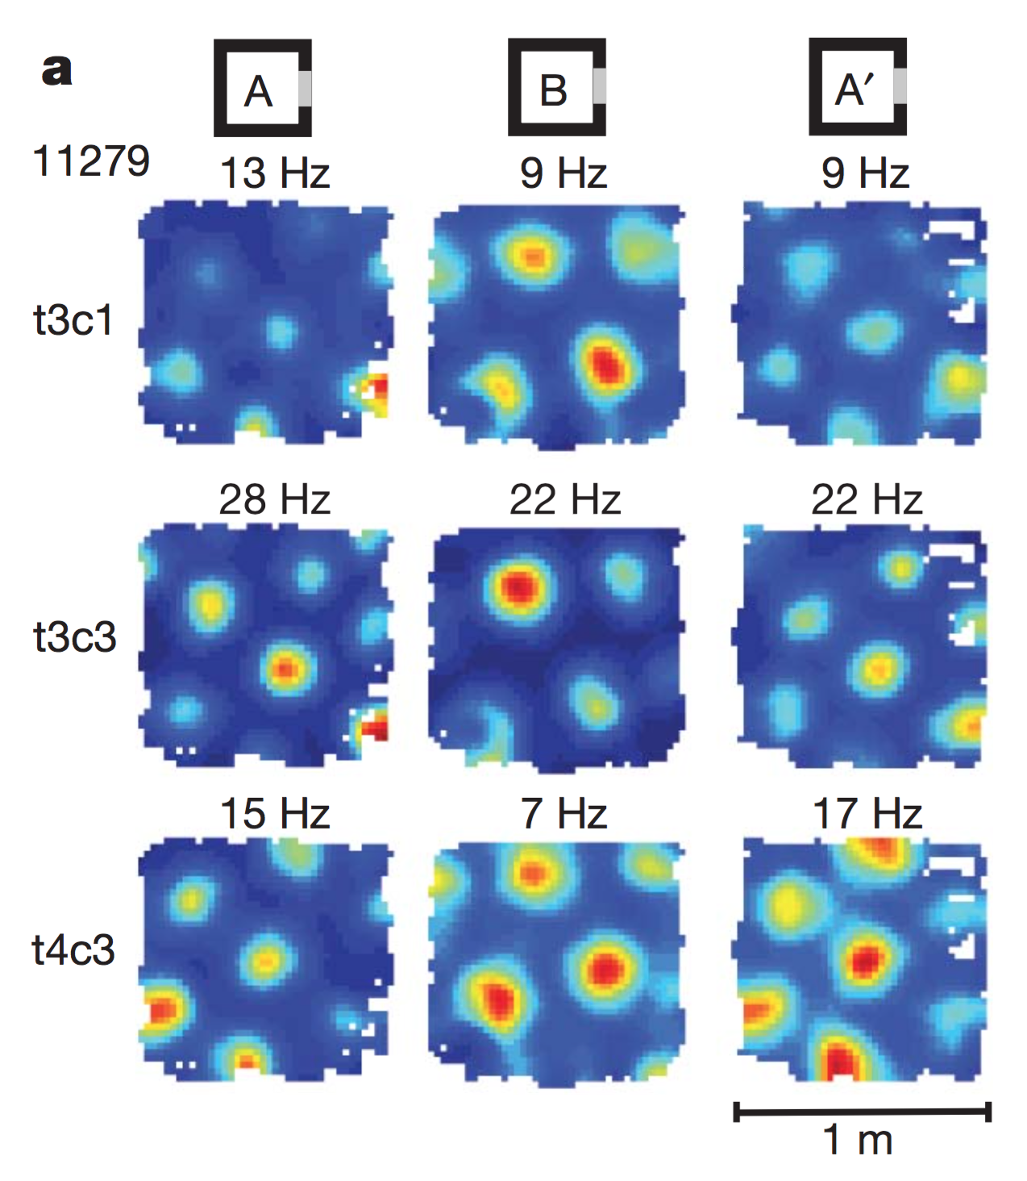
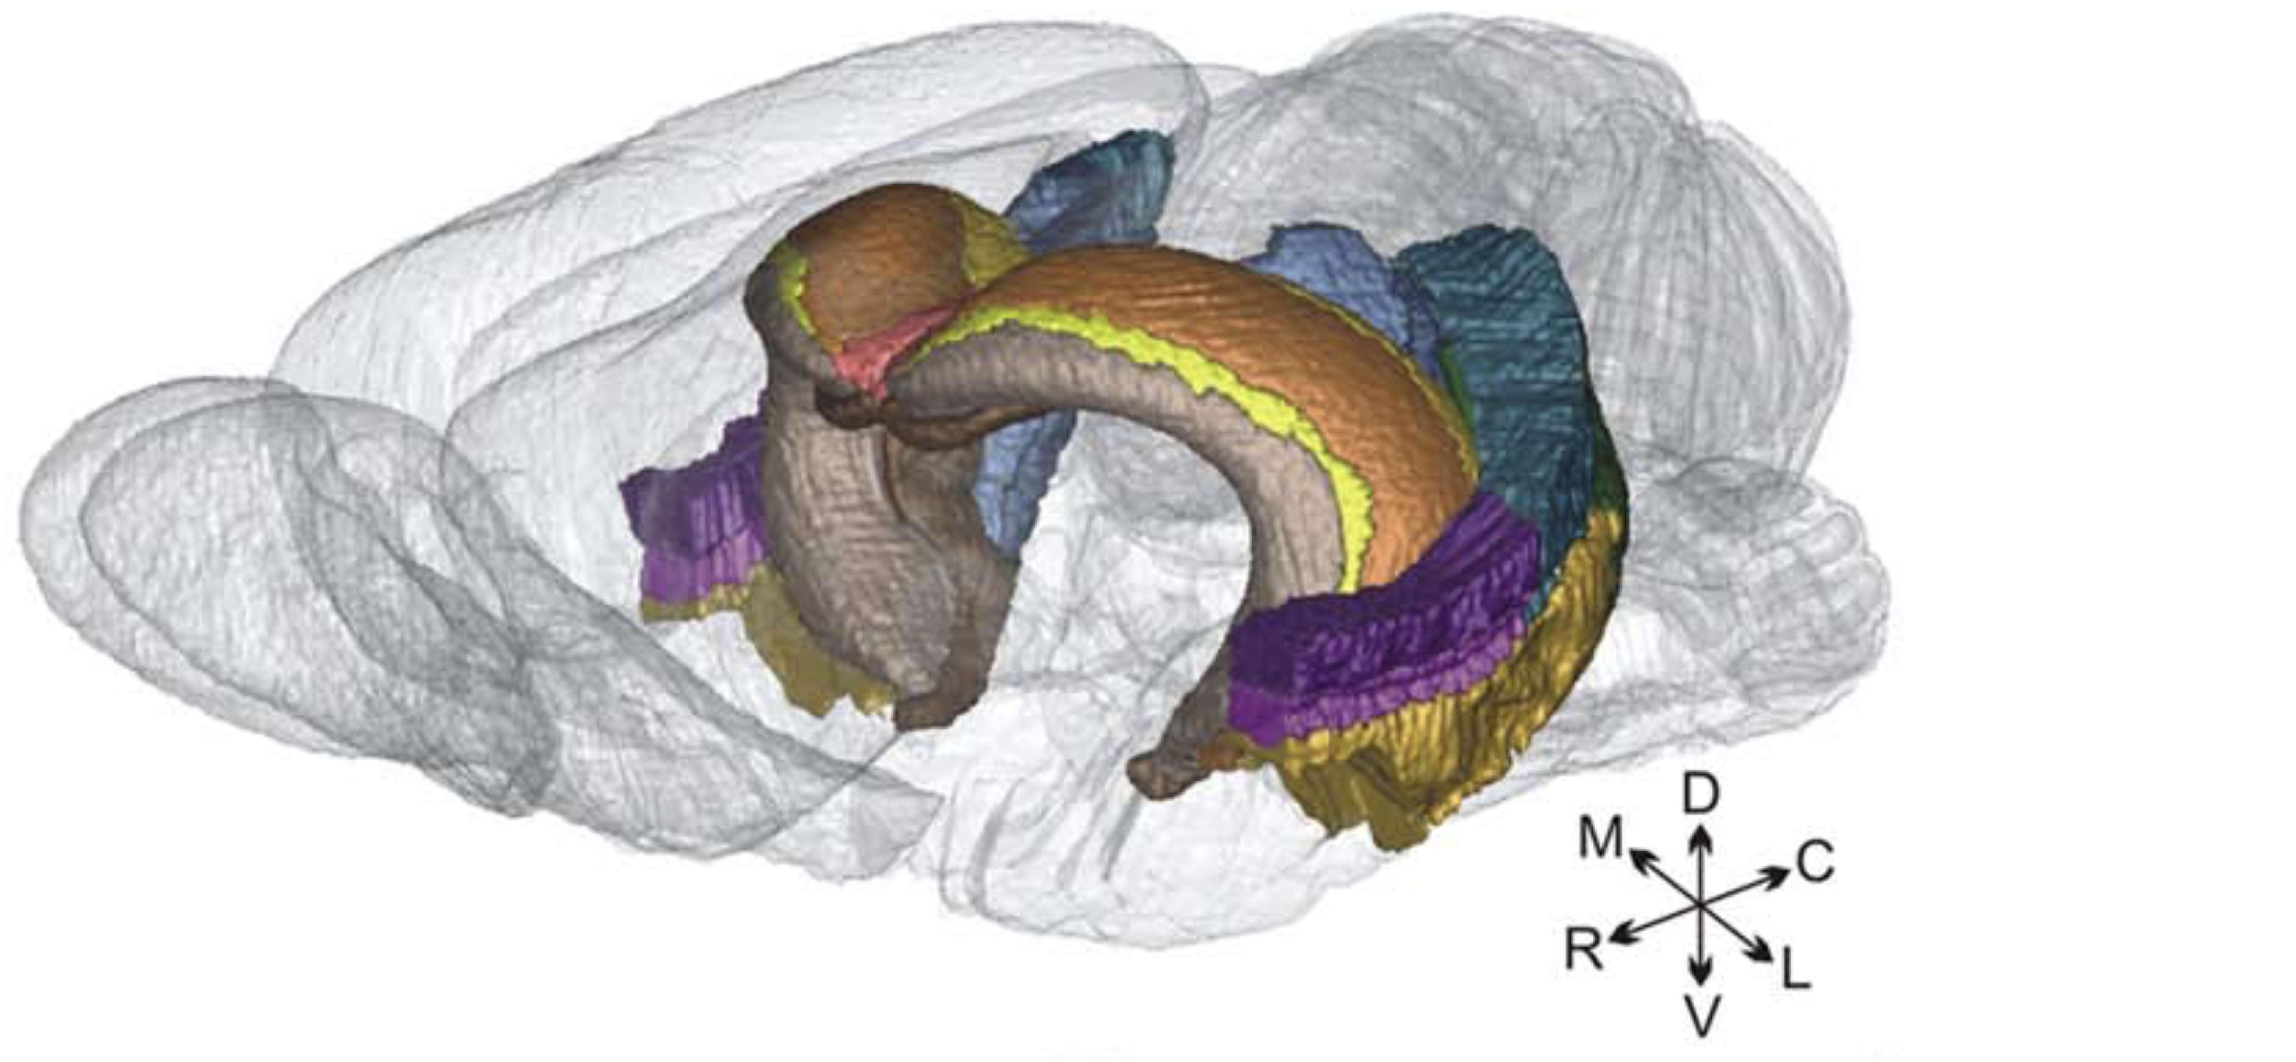
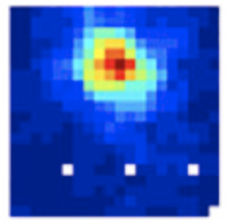
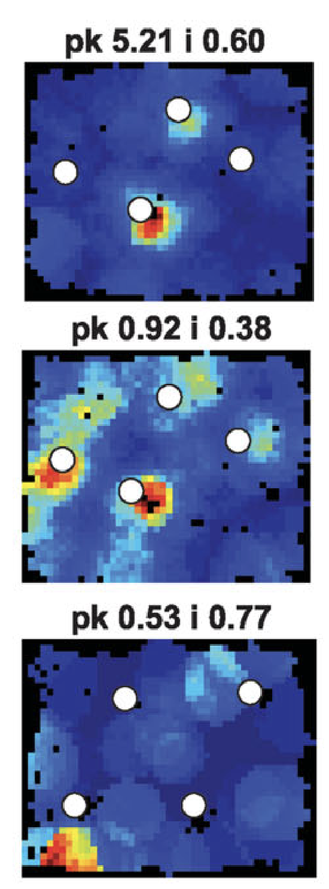
Hippocampus
Medial Entorhinal
Cortex (MEC)
Lateral Entorhinal
Cortex (LEC)
Boccara CN, et al. (2015). Hippocampus, 25: 838

Slide 7
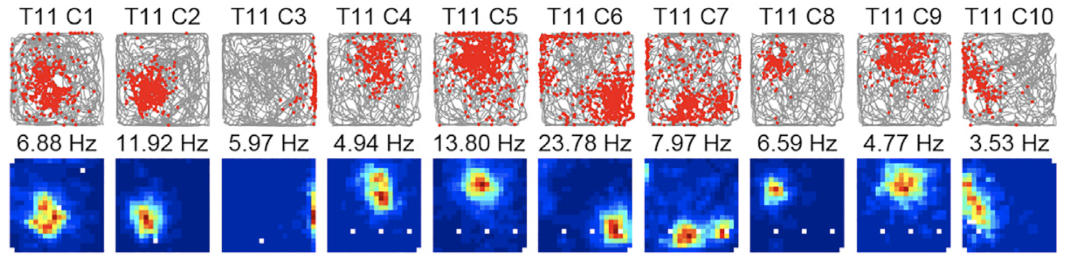
Boccara CN, et al. (2015). Hippocampus, 25: 838

Slide 8
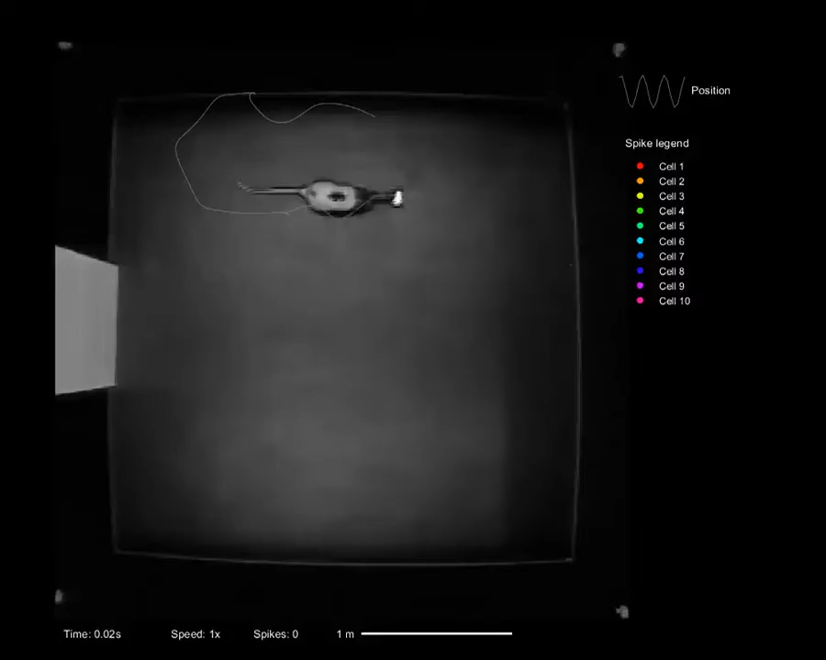
Not Actual Speed
Video Credit: R. Grieves

Slide 9
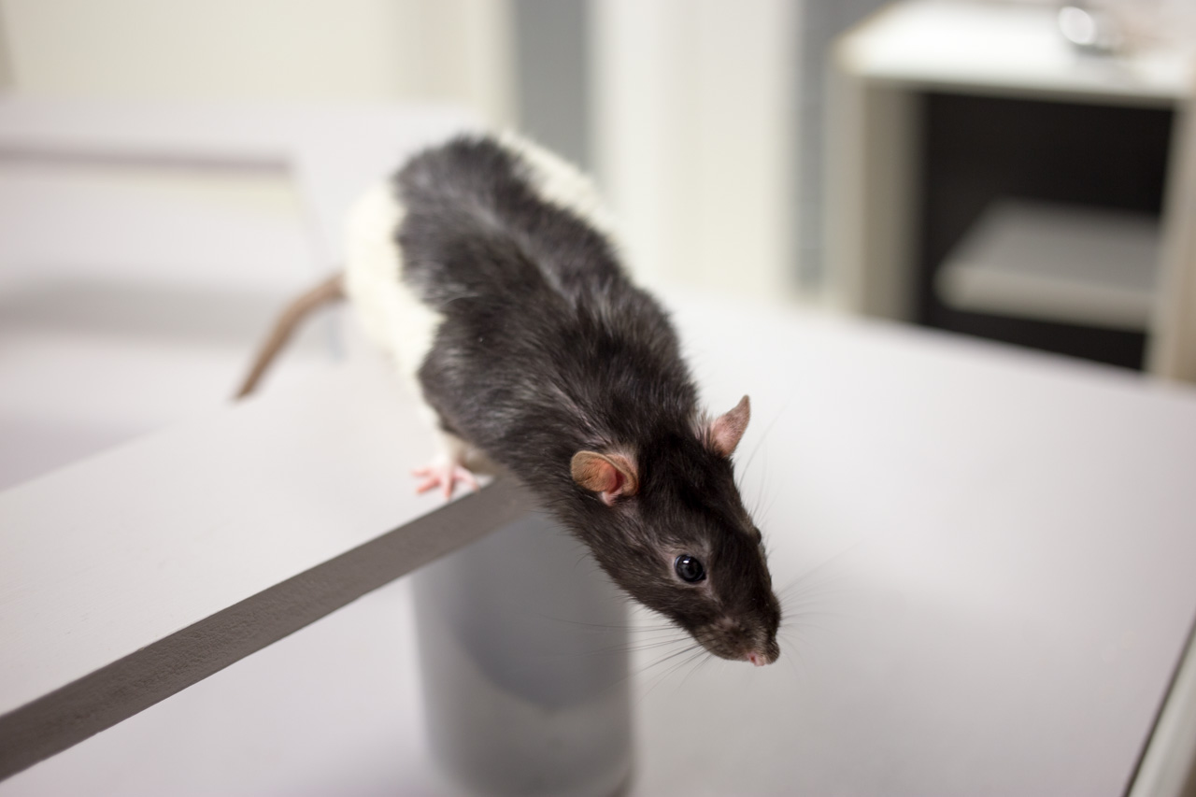
Embodied cognition
Progressive articulation vs. forward models
Embodiment-first theories invert our view of cognition as integrating isolated channels of sensory information into unified internal models, to one of articulating dynamical boundaries within existing global states that already reflect an organism’s cumulative experience in its world (umvelt).
Monaco and Hwang. (2022). Cognitive Computation
Notes:
In humans, this lifelong context of prior articulations inescapably conditions the meaning that we discern from the momentary flow of experience and, therefore, also guides our planning and future behavior.

Slide 10
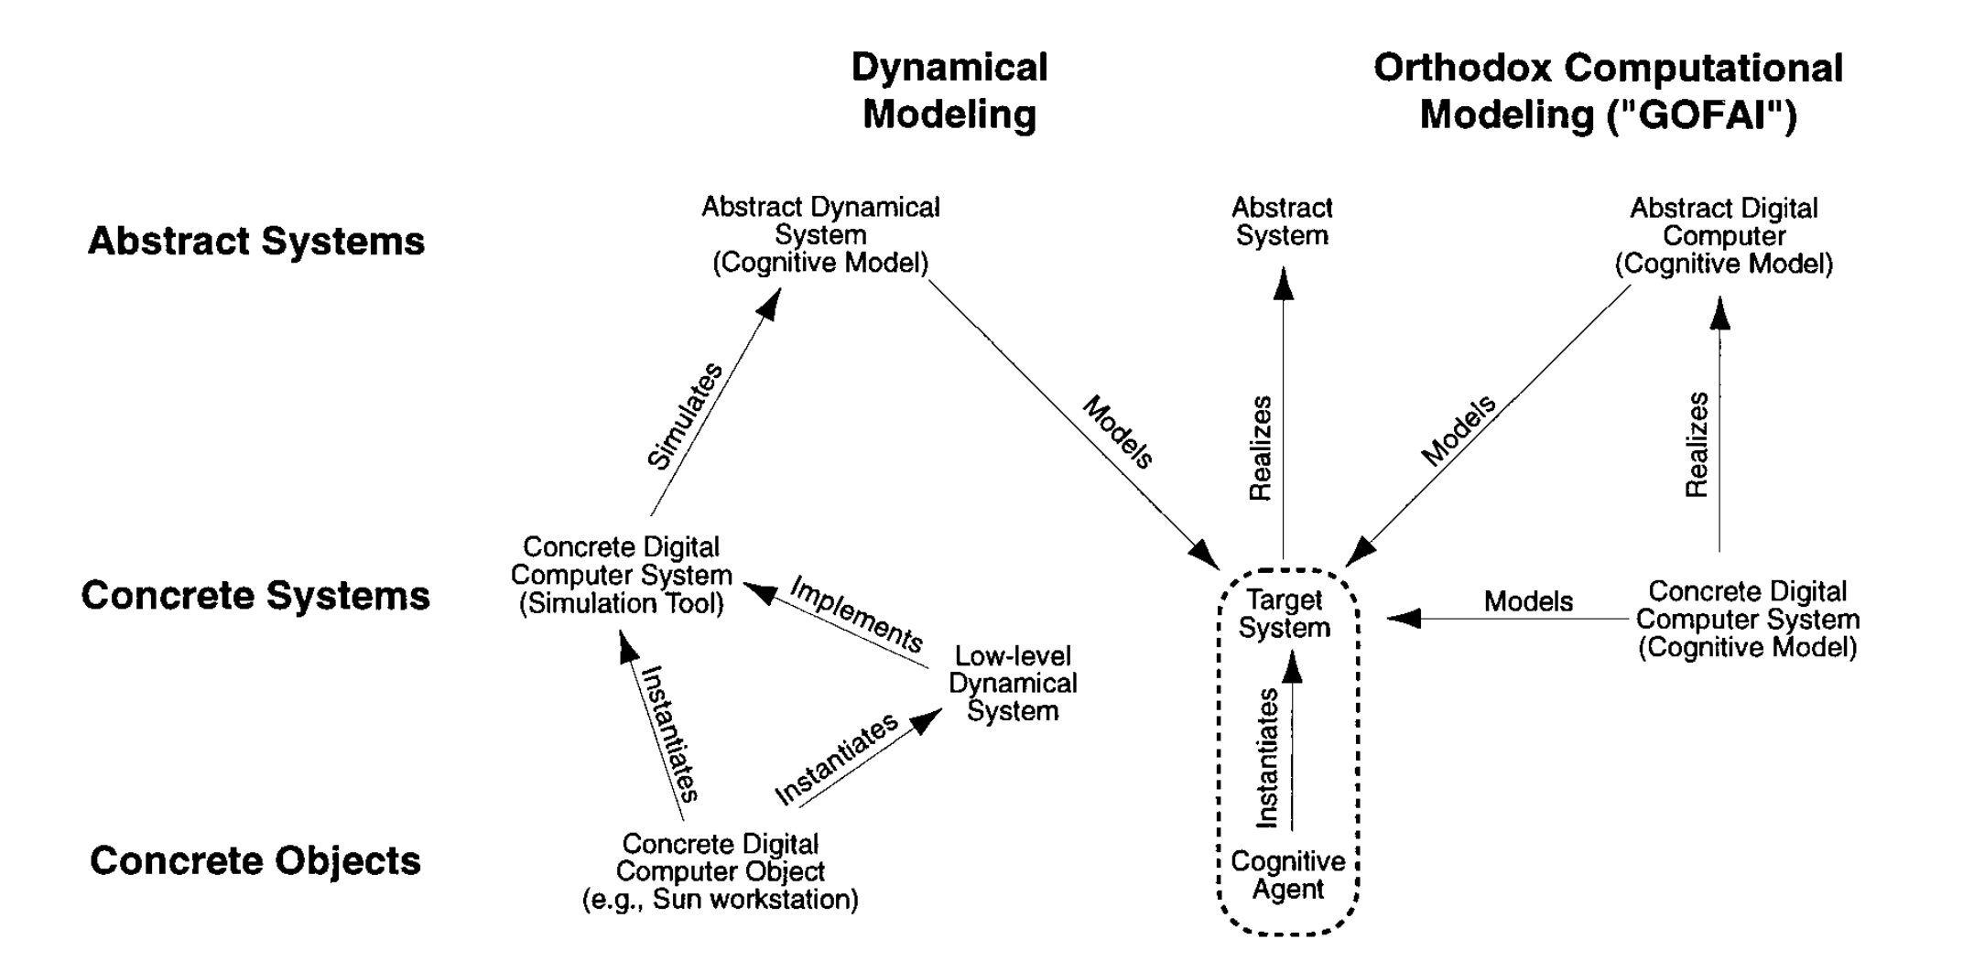
Dynamical systems view of cognition
Temporal unfolding and the locus of agency
van Gelder. (1998). Behav Brain Sci, 21(5): 615

Slide 11
Reorganizing the control flow
Perceptual control internalizes input, output, and goals
Goal-setting autonomy recognizes the agency inherent in embodied living systems
  Animals have goals and those goals govern their behavior
Environmental control is established through internal perceptual control of corresponding sensory input
Mansell (ed.). (2020). International Handbook of Perceptual Control Theory

Slide 12
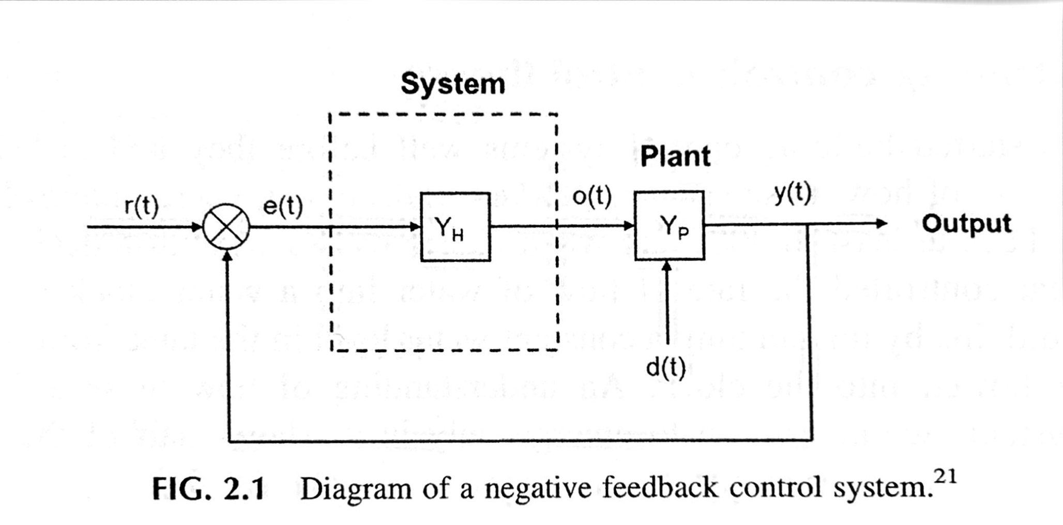
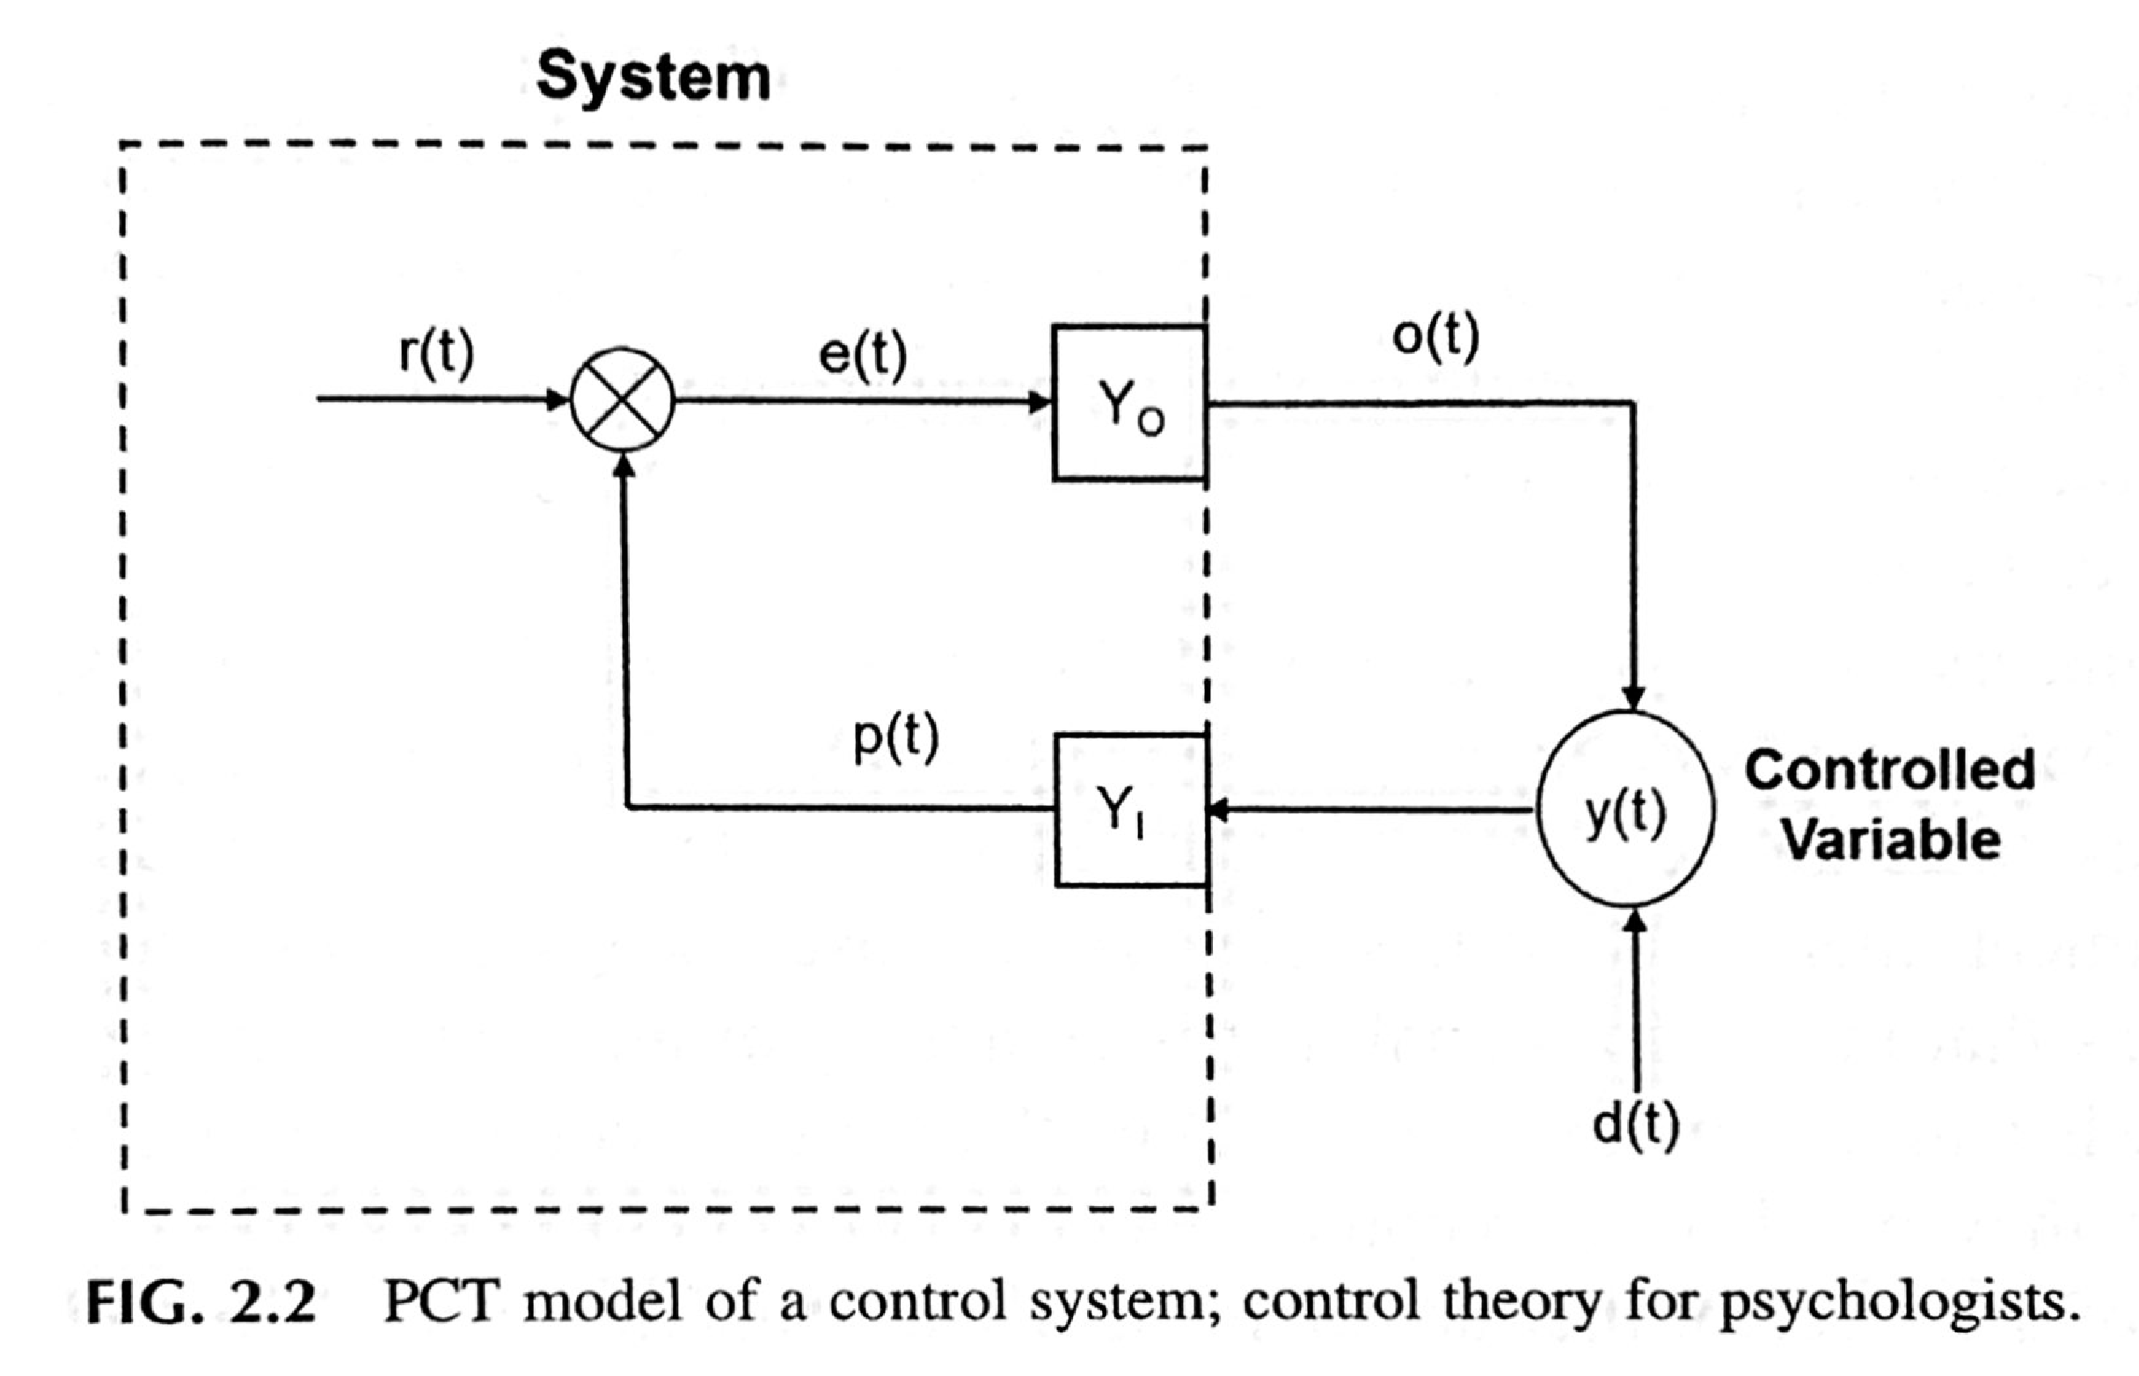
Reorganizing the control flow
Perceptual control internalizes input, output, and goals
Mansell (ed.). (2020). International Handbook of Perceptual Control Theory

Slide 13
Reorganizing the control flow
Perceptual control internalizes input, output, and goals
Behavior is no longer the output of the neural system
  Outputs (Y0) are cascading internal reference signals
  The lowest control levels form the self–nonself boundary that interacts with the environment
Internal perceptions of controlled environmental variables are controlled, not behavior
Mansell (ed.). (2020). International Handbook of Perceptual Control Theory

Slide 14
Active inference
The generative role of behavior
Optimal (Bayesian) inference in feedback-driven generative models require active inference: actions that maximize model evidence by balancing internal active-state (self) entropy with external sensory-state (nonself) entropy.
  Agents learn massively distributed internal feedback models by adaptively balancing information streams arising at the self–nonself boundary.
Friston K. Hierarchical models in the brain. PLOS Comput Biol. 2008;4: e1000211
Friston K. What is optimal about motor control? Neuron. 2011;72:488–98.

Slide 15
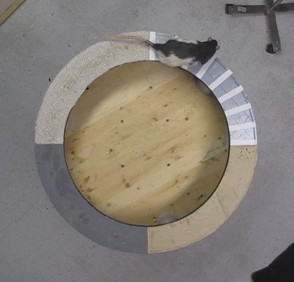
Video Credit: G. Rao
5x Speed
Notes:
A rat is being trained to run anti-clockwise laps. Between bouts of running, the rat will stereotypically swing its head laterally (toward the exterior or interior of the track) and briefly pause before recommencing forward locomotion. Chocolate sprinkles motivate track running.

Slide 16
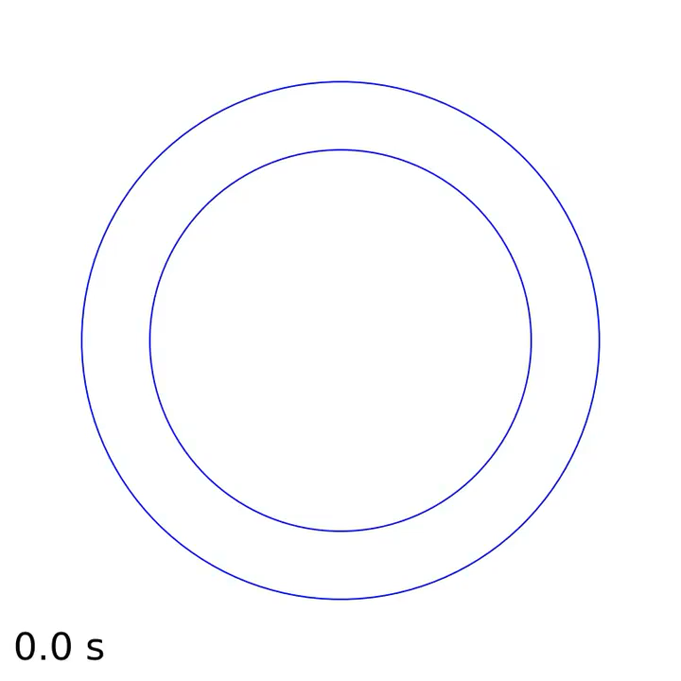
Example
Monaco JD, et al. (2014). Nature Neuroscience, 17: 725

Slide 17
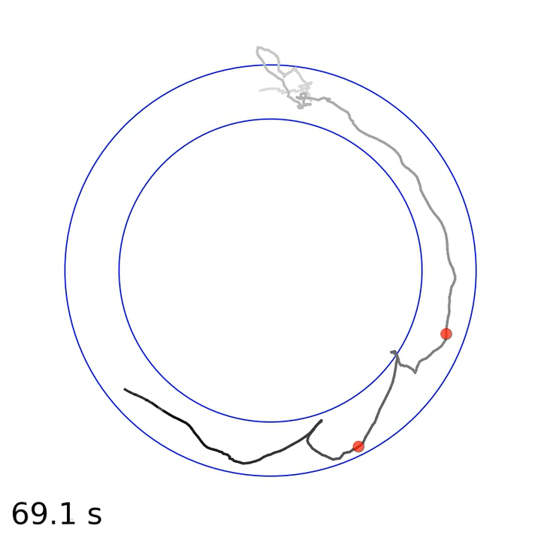
Example
Location of scan firing
Monaco JD, et al. (2014). Nature Neuroscience, 17: 725
Notes:
This is an example of one place field event from one place cell in one rat, but the dataset consisted of 36 rats, 5510 place field recordings, and 963 place-field events, all of which was data collected by 4 different experimenteres in the lab over 10 years. Now, putting together all 963 place-field events, you can see…

Slide 18
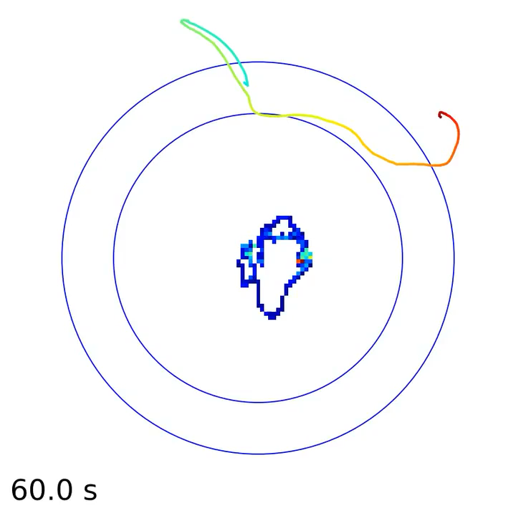
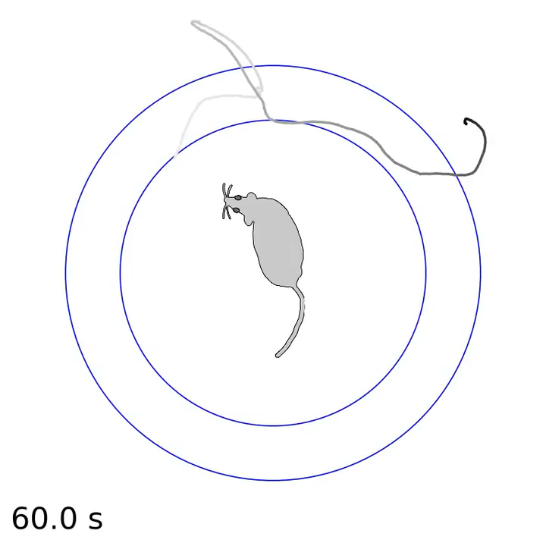
Quantifying Lateral Head-Scan Behaviors
Monaco JD, et al. (2014). Nature Neuroscience, 17: 725

Slide 19
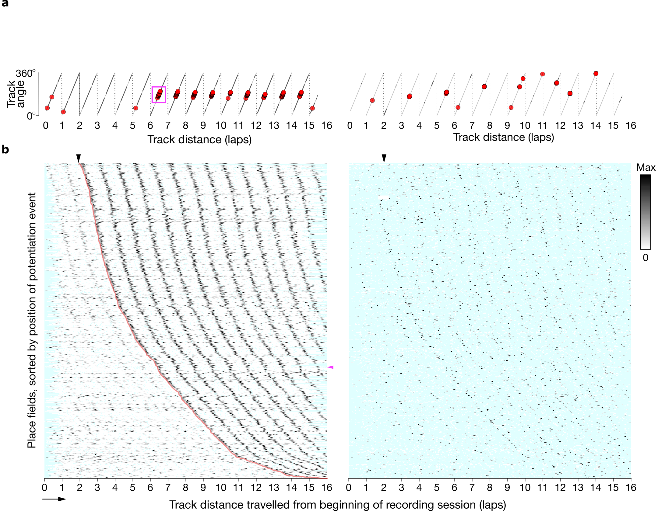
Place-Field Firing
Run w/ no firing
Run w/ firing
Not running
Recordings
Unrolled Lap Position
Monaco JD, et al. (2014). Nature Neuroscience, 17: 725
Notes:
…

Slide 20
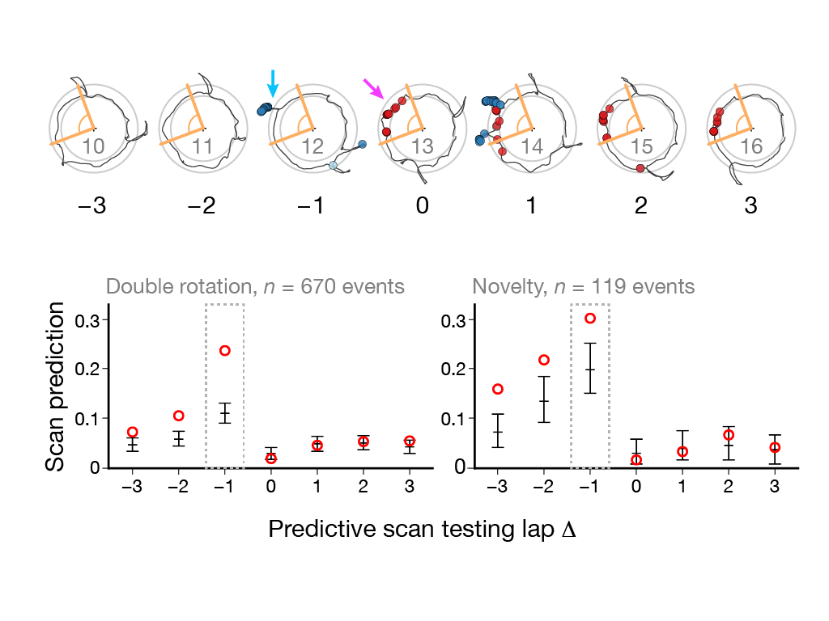
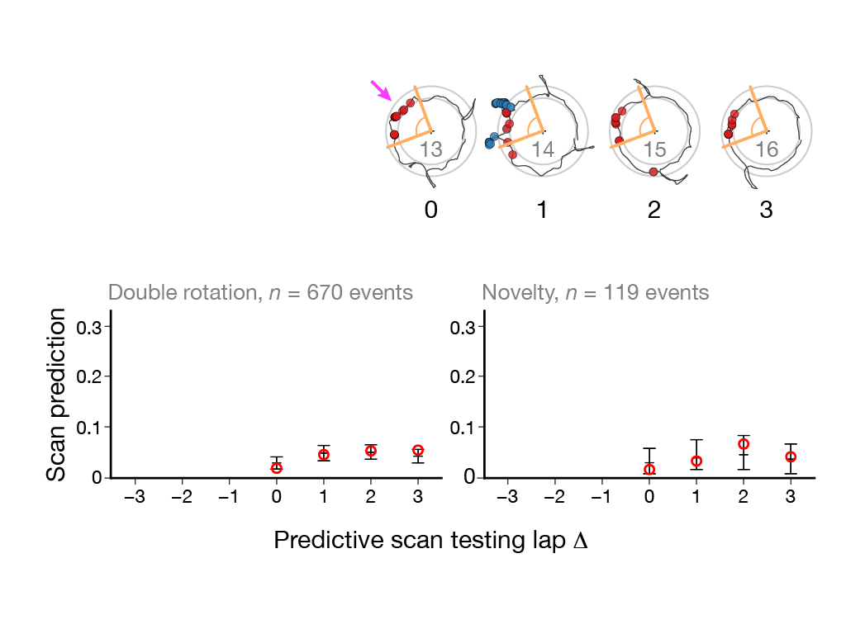
Significant Predictive Value: Scan Firing→Place-Field Event
• Overall Result:
Computed over all criterion scan-firing events in all animals (n=36), subregions (CA3, CA1), experiments (novelty vs. double rotation), training days, and session number (up to 5).
• Scan Predictive Value:
Fraction of criterion scan-firing events that fall within the track-angle bounds of a new or potentiated place field on the lap prior to the event (∆=–1)
Monaco JD, et al. (2014). Nature Neuroscience, 17: 725
Notes:
Now

Slide 21
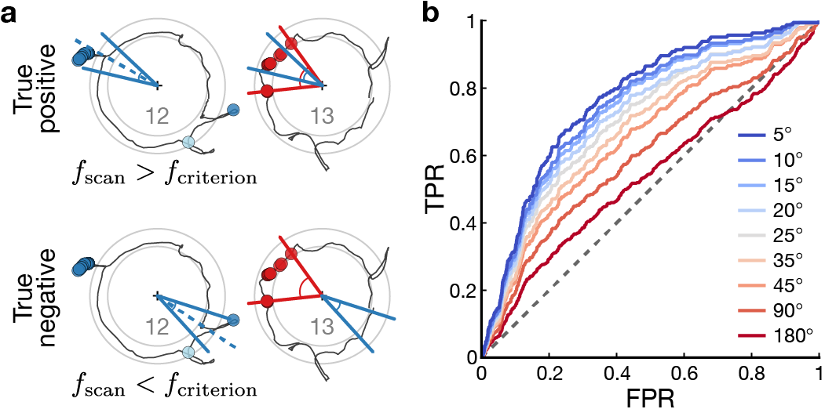
ROC Analysis: Place-Field Event→Prior Co-Localized Head Scan
• Abrupt place-field changes were diagnostically associated with significant high-firing head scans on the previous lap, with the association increasing to 75% AUC as the specificity of spatial co-localization approached ±5º
Monaco JD, et al. (2014). Nature Neuroscience, 17: 725

Slide 22
Active inference
Cognitive map-building driven by autonomous head-scan sampling
Monaco JD, et al. (2014). Nature Neuroscience, 17: 725

Slide 23
Integrative framework for neurodynamical cognition
Network structure:
(2) Temporal dynamics:
(3) Agentic interaction:
Monaco and Hwang. (2022). Cognitive Computation

Slide 24
Integrative framework for neurodynamical cognition
Network structure:
(2) Temporal dynamics:
Example: Nested oscillations with phase-amplitude coupling between levels of the pseudohierarchy
(3) Agentic interaction:
Monaco and Hwang. (2022). Cognitive Computation

Slide 25
Integrative framework for neurodynamical cognition
Network structure:
(2) Temporal dynamics:
(3) Agentic interaction:
Example: Attentive head-scanning behavior (Monaco et al., 2014)
Monaco and Hwang. (2022). Cognitive Computation

Slide 26
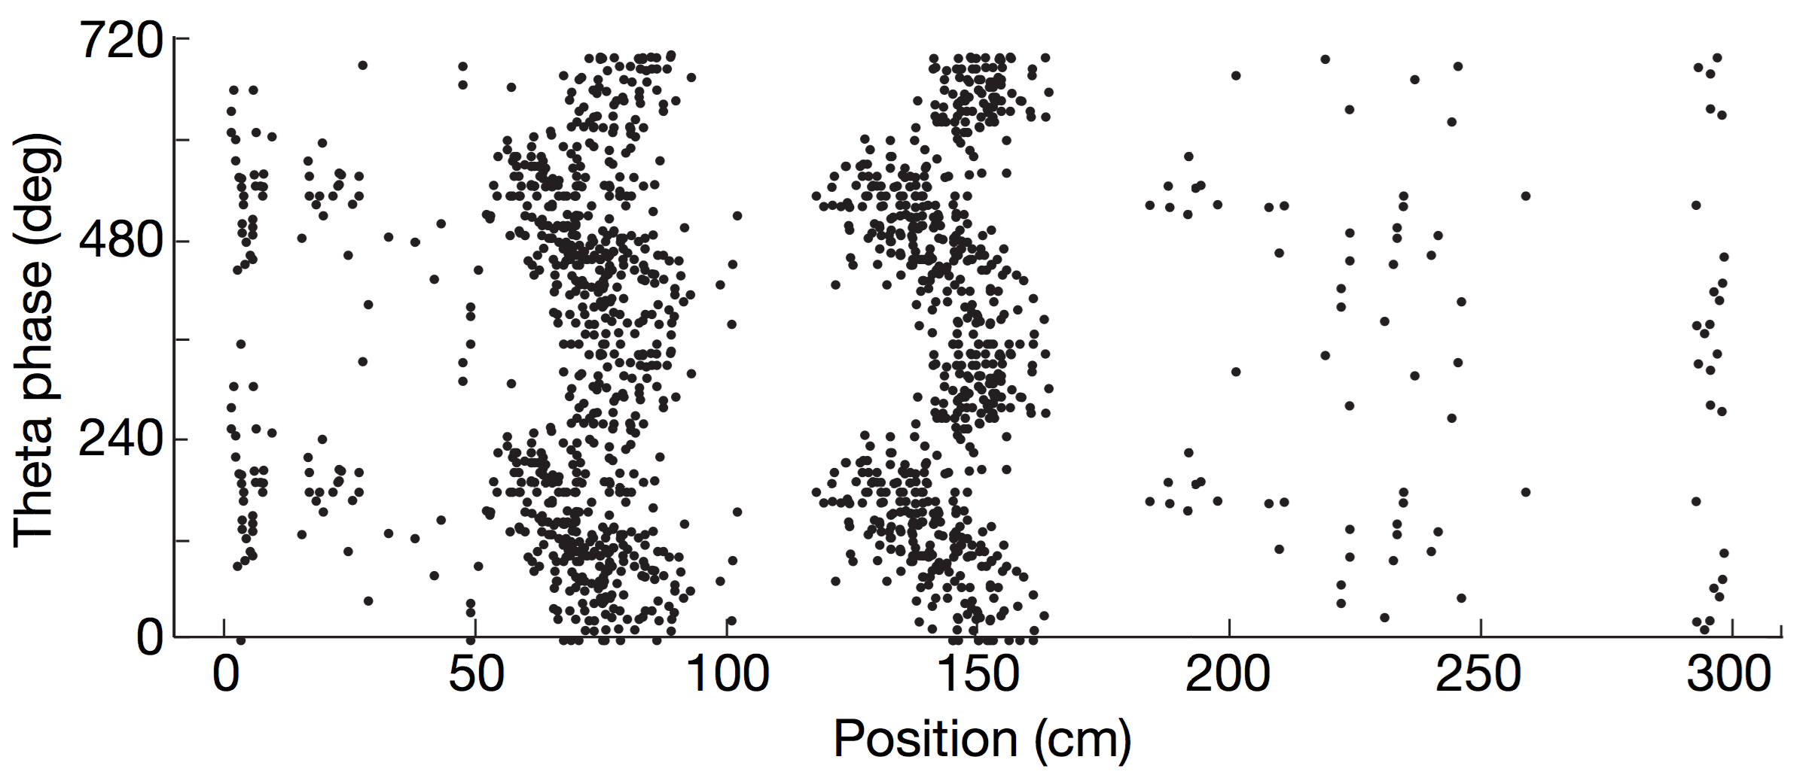
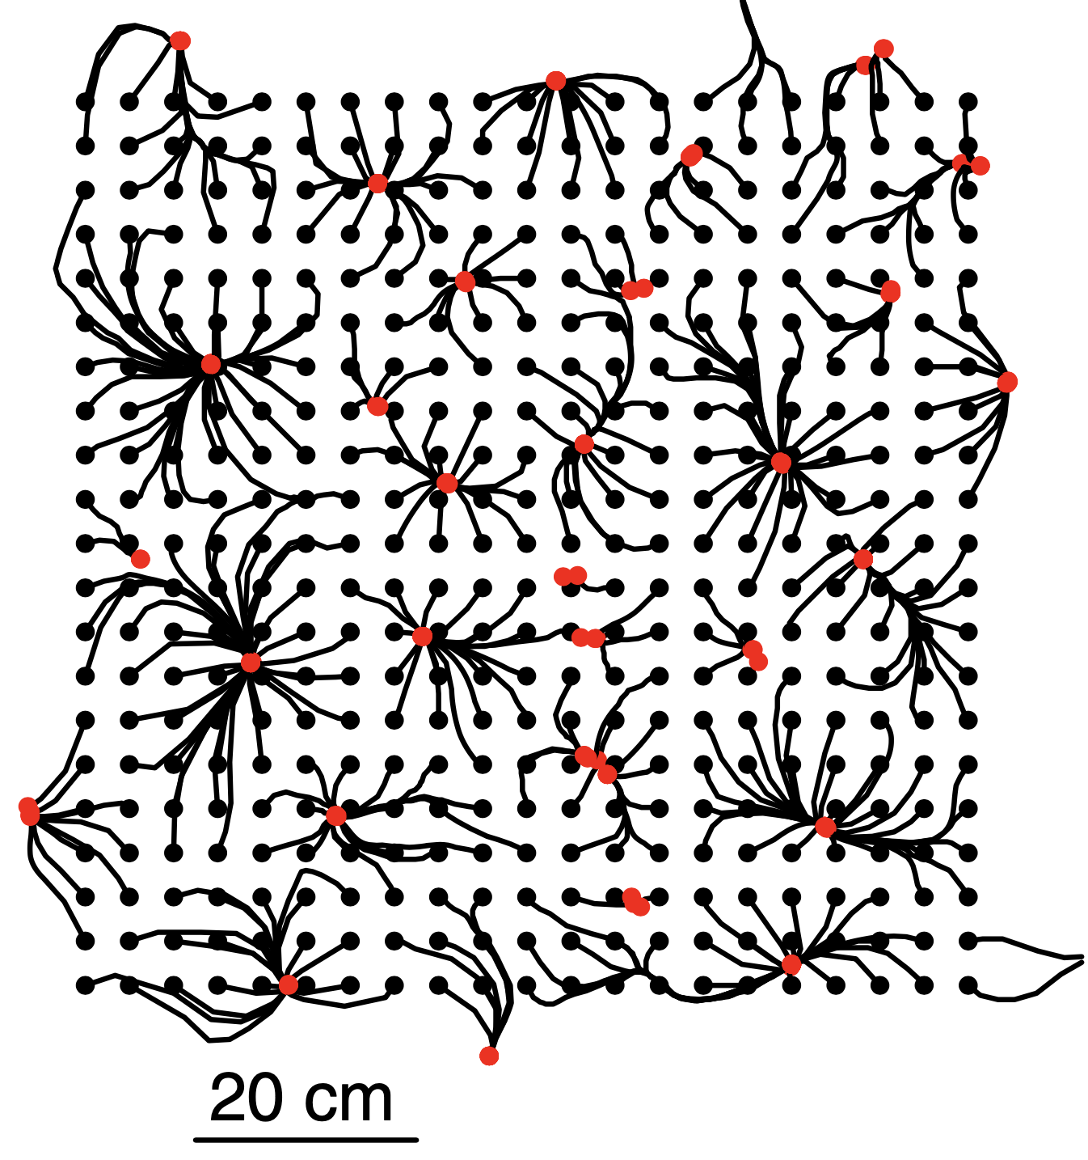
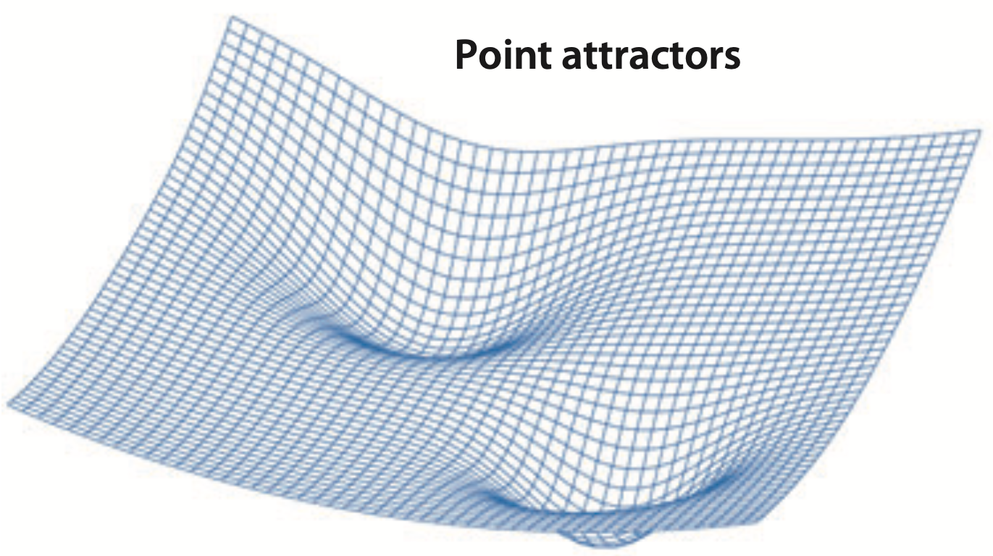
Temporal and Population Dynamics
Key Building Blocks
Local oscillations and neuronal synchrony
  Temporal coding with oscillatory phase
  O’Keefe & Recce (1993) — Theta-phase precession of hippocampal place-field firing
Hafting et al. (2008)
Emergent self-organizing states arising from recurrence and feedback in structured networks
  Hopfield networks (1982) — Pattern completion supports content-addressable memory with (limited) generalization
  Memory retrieval as a state-space trajectory that probes basins of attraction
Knierim & Zhang (2012)
Hedrick & Zhang (2016)
Monaco and Hwang. (2022). Cognitive Computation

Slide 27
Temporal and Population Dynamics
Key Building Blocks
Local oscillations and neuronal synchrony
  Temporal coding with oscillatory phase
  O’Keefe & Recce (1993) — Theta-phase precession of hippocampal place-field firing
Emergent self-organizing states arising from recurrence and feedback in structured networks
  Hopfield networks (1982) — Pattern completion supports content-addressable memory with (limited) generalization
  Memory retrieval as a state-space trajectory that probes basins of attraction
Monaco and Hwang. (2022). Cognitive Computation

Slide 28
Papers
Neurodynamical principles for embodied intelligence
Monaco JD and Hwang GM. (2022). Neurodynamical computing at the information boundaries of intelligent systems. Cognitive Computation.
doi: 10.1007/s12559-022-10081-9
Monaco JD, Rajan K, and Hwang GM. (2021). A brain basis of dynamical intelligence for AI and computational neuroscience. ArXiv Preprint. arxiv:2105.07284
Head scanning modifies cognitive maps
Monaco JD, Rao G, Roth ED, and Knierim JJ. (2014). Attentive scanning behavior drives one-trial potentiation of hippocampal place fields. Nature Neuroscience, 17(5), 725–731. doi: 10.1038/nn.3687
→ https://jdmonaco.com/pubs

